Slide 1
Object-Oriented Frameworks
Dirk Riehle, FAU Erlangen
ADAP D05
Licensed under CC BY 4.0 International

Slide 2
Agenda
Code and runtime components
Object oriented frameworks
Use-client interface
Inheritance interface
Framework extensions
Meta-object protocol
Layers vs. tiers revisited

Slide 3
1. Components

Slide 4
Components
A component is some entity with a defined boundary; it should have
  High internal cohesion and low external coupling
Components can be composed from smaller components
  Atomic components may be files (code) or functions (runtime)
Code components are code
  Source code in directories, compiled binaries, etc.
Runtime component are data (with associated code)
  May or may not map on code components
You always either talk about code or runtime components

Slide 5
Code Components (Classes)
A set of source code files, compiled into a binary or related delivery format
  With high cohesion and low coupling
Example delivery formats for code components
  Java: .class files, jar-files
  C: .o files, shared libraries
  Web servers: war files, etc.
Source code is usually compiled into one binary
  Not reused as source code (not even generics/templates)
Code components can be aggregated
  Used to be done mainly for binaries, not source code; is changing

Slide 6
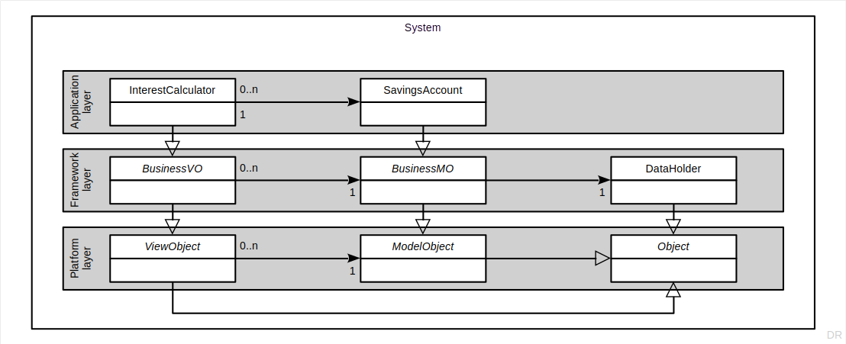
Code Components and Layers (Recap)

Slide 7
Runtime Components (Objects)
One or more runtime entities (objects, data) grouped into an entity
  With high cohesion and low coupling
The boundary around the entities often only exists in an architect’s mind
  May be captured as part of a system model, but gets resolved at runtime
The boundary around the entities can be made more explicit though
  Closures
  Threads or agents
  Processes
  Containers
Runtime components can be composed into larger runtime components

Slide 8
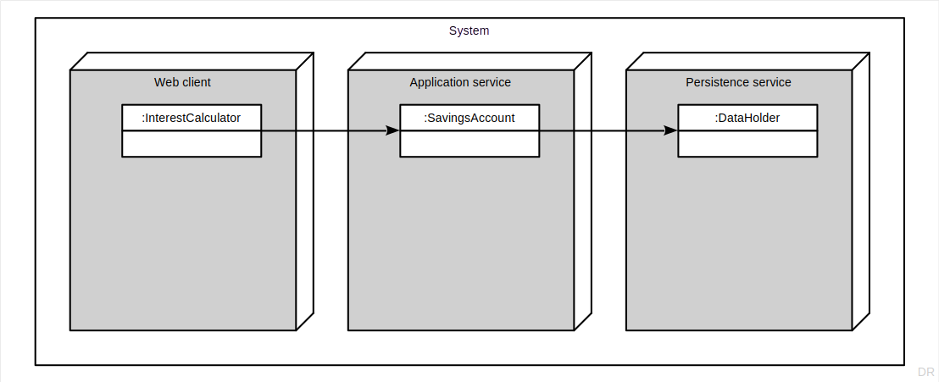
Runtime Components and Tiers (Recap)

Slide 9
Types of Code Components
Small code components
Functions
Classes
Larger code components
Libraries (also toolkits)
Frameworks
Platforms

Slide 10
2. Object-Oriented Frameworks

Slide 11
Object-Oriented Framework
An object-oriented framework
Is an abstract object-oriented design that can be reused
Has default implementation classes that can be used
Typically covers one particular application domain

Slide 12
White-Box Framework
A white-box framework is an object-oriented framework that
Is mostly used (applied) by implementing subclasses
Requires the users to understand how it works internally
Is often still young and immature i.e. developing rapidly

Slide 13
Black-Box Framework
A black-box framework is an object-oriented framework that
Is mostly applied (used) by composing instances
Is typically easier to use than a white-box framework
Is typically in its mature stages (all code is there)

Slide 14
Frameworks vs. Libraries / Toolkits 1 / 2
A framework has high cohesion, a library has low cohesion
A framework may be both white-box or black-box, a library only black-box

Slide 15
Frameworks vs. Libraries 2 / 2
Frameworks
Provide an abstract design
  High cohesion of classes
  Inheritance and delegation
  Inheritance interfaces
More difficult to use
Libraries
Provide no abstract design
  Mostly individual classes
  No or little use of inheritance
  Only use relationships
Easier to use

Slide 16
Framework Interfaces
Use-client interface
Inheritance interface
Meta-object protocol

Slide 17
3. Use-Client Interface

Slide 18
Use-Client Interface
The use-client interface is the traditional interface
  Invoked using method calls by client objects on framework objects
Best practices of defining use-client interfaces
  An abstract object-oriented design that reflects the domain
    Using interfaces, abstract classes, and implementation classes
    Using collaborations spelling out roles and their responsibilities
    Using exceptions to document behavior in case of failure
  With clear idea of types of objects, for example, value objects
  With clear idea of patterns employed to structure the design

Slide 19
4. Inheritance Interface

Slide 20
Inheritance Interface
The inheritance interface uses polymorphism
  Subclasses extend the design while conforming to it
  Leads to inverted control-flow, a.k.a. “Hollywood principle”
Best practices of defining inheritance interfaces
  An abstract object oriented design that reflects the domain
    Using the abstract superclass rule
    Using the narrow inheritance interface principle
  With clear idea of how to structure the interface
    Primitive and composed methods
    Factory method, template, method, etc.
  Document extension points

Slide 21
Happy Go Lucky Inheritance Interfaces
To be done

Slide 22
5. Framework Extensions

Slide 23
Framework Extension
A (framework) extension point (class) is
A framework class and its inheritance interface intended to be subclassed
A framework extension is
A set of classes created to apply (use) the framework in its domain
Always a white-box use of the framework
Framework and framework extension are separate code components

Slide 24
Happy Go Lucky Framework Extensions
To be done

Slide 25
6. Meta-Object Protocols

Slide 26
Meta-Object Protocol
A meta object is
An object describing another object (the base object)
A meta-object protocol (MOP) is
A use-client interface to the meta objects of a system
The most common MOP is a language’s reflection API

Slide 27
Happy Go Lucky Meta-Object Protocol
To be done

Slide 28
7. Layers vs. Tiers

Slide 29
Runtime Objects in a Three-Tier System

Slide 30
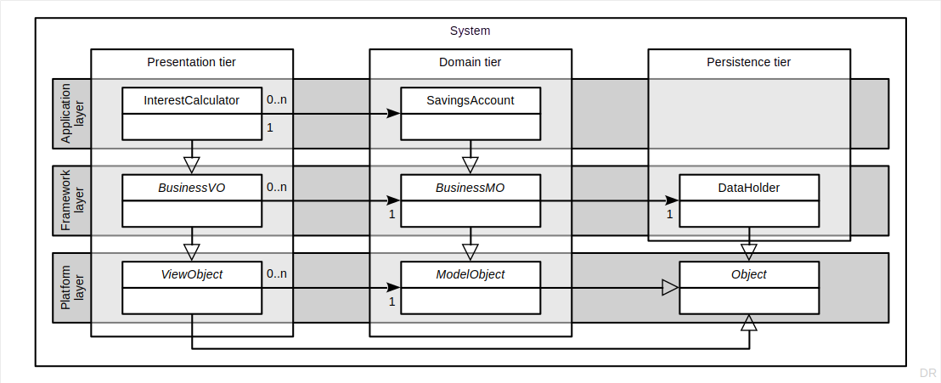
The Code Structure of a Three-Tier System

Slide 31
Layers as Stacking Mechanism
Dependencies go from higher to lower code layer
Explicit method calls go from higher to lower layer
Control flow either returns normally or by way of callbacks
Strict stacking allows only for dependencies on next lower level
Code component dependencies form a directed acyclic graph (DAG)

Slide 32
Tiers as Stacking Mechanism
A runtime component (i.e. an object)
Always only exists within one tier
Is aggregated from data across the code layers

Slide 33
Summary
Code and runtime components
Object oriented frameworks
Use-client interface
Inheritance interface
Framework extensions
Meta-object protocol
Layers vs. tiers revisited

Slide 34
Thank you! Any questions?
dirk.riehle@fau.de – https://oss.cs.fau.de
dirk@riehle.org – https://dirkriehle.com – @dirkriehle

Slide 35
Legal Notices
License
Licensed under the CC BY 4.0 International license
Copyright
© 2012, 2018, 2024 Dirk Riehle, some rights reserved

